Slide 1
3x + 4 = 10
(-4) (-4)
3x = 6
(÷3) (÷3)
x = 2

Slide 2
-2x + 5 = 13
(-5) (-5)
-2x = 8
(÷-2) (÷-2)
x = -4

Slide 3
3x = 6 2
(x2) (x2)
3x = 12
(÷3) (÷3)
x = 4

Slide 4
6(4x – 3) + 7(x + 1) = 9
24x – 18 + 7x + 7 = 9
31x – 11 = 9
(+11) (+11)
31x = 20
(÷31) (÷31)
x = 20
31

Slide 5
5x + 7 = 8x - 5
(-5x) (-5x)
7 = 3x -5
(+5) (+5)
12 = 3x
(÷3) (÷3)
4 = x

Slide 6
2x + 10 ≥ 16
Draw this inequality on a number line
(-10) (-10)
2x ≥ 6
(÷2) (÷2)
x ≥ 3
-1
0
1
2
3
4
5

Slide 7
-4x + 2 ≤ -3
Draw this inequality on a number line
(-2) (-2)
-4x ≤ -5
(÷-4) (÷-4)
x ≥ 1.25
-1
0
1
2
3
4
5

Slide 8
y = 2x + 2
….
Intercept = 2
….
Gradient = 2
What is the gradient?
What is the intercept?

Slide 9
2y = 10 – 4x
(÷2) (÷2)
y = 5 – 2x
……..
Gradient = -2
….
Intercept = 5
What is the gradient?
What is the intercept?

Slide 10
-4x + 3y = 12 + 2x
(+4x) (+4x)
3y = 12 + 6x
(÷3) (÷3)
….
Intercept = 2
….
Gradient = 2
y = 4 + 2x
What is the gradient?
What is the intercept?

Slide 11
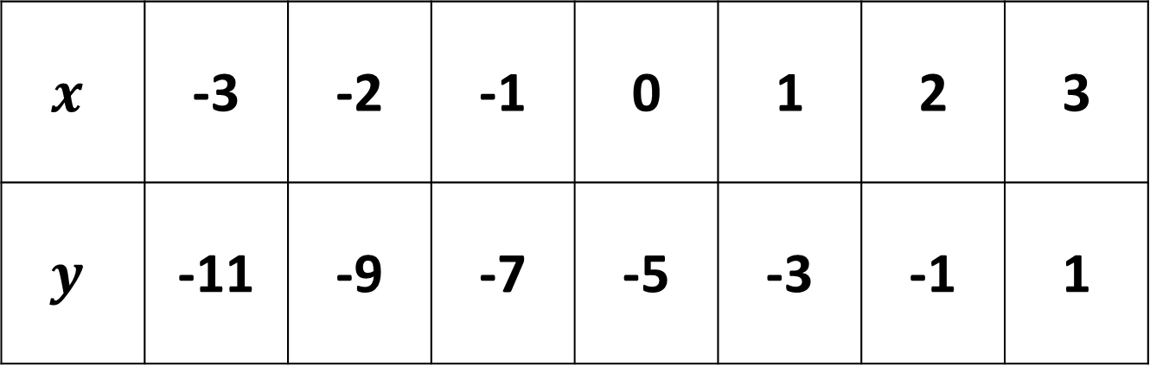
$$x$$ | -3 | -2 | -1 | 0 | 1 | 2 | 3
$$y$$ | -11 | -9 | -7 | -5 | -3 | -1 | 1
+2
+2
+2
+2
+2
+2
Gradient = 2
Intercept = -5
On our table the gradient is the amount y increases by each time
What is the gradient?
What is the intercept?

Slide 12
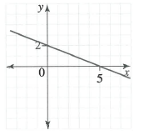
Find the equation of the line
-2
Gradient = -2/5
5
Intercept = 2
y = -2/5x + 2

Slide 13
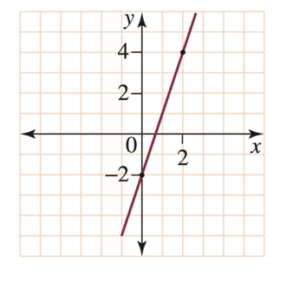
Find the equation of the line
Gradient = 6/2 = 3
6
Intercept = -2
2
y = 3x - 2

Slide 14
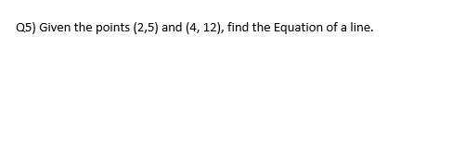
Gradient = 7/2 = 3.5
(4,12)
12 = 3.5(4) + c
12 – 5 = 7
12 = 14 + c
(-14) (-14)
y = 3.5x + c
c = -2
(2,5)
y = 3.5x - 2
4 – 2 = 2

Slide 15
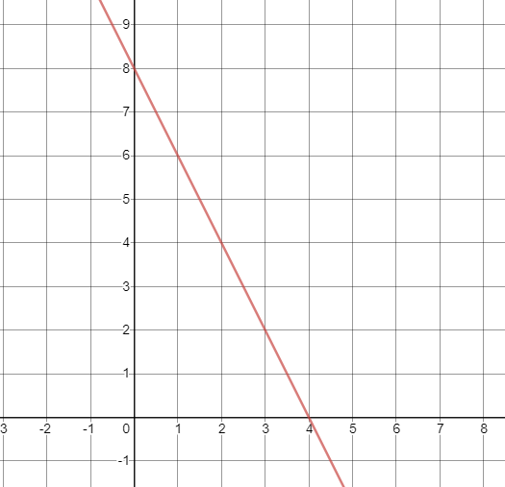
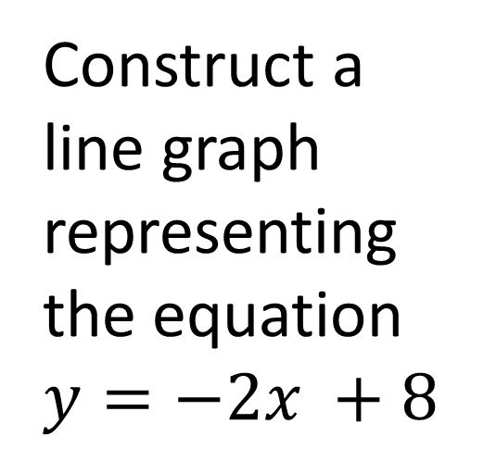
Construct a line graph representing the equation $y=−2x +8$
Gradient = -2
Intercept = 8

Slide 16
Q7) You are investigating prices for having business cards printed for your new games store. A local printing company charges a flat rate of $250 for the materials used and $40 per hour for labour. [2,2,2,2 = 8 Marks]
If h is the number of hours of labour required to print the cards, construct an equation for the cost of the cards, C.

Slide 17
You have budgeted $1000 for the printing job. How many hours of labour can you afford? Give your answer to the nearest minute.

Slide 18
The printer estimates that it can print 1000 cards per hour of labour. How many cards will be printed with your current budget?

Slide 19
An alternative to printing is photocopying. The company charges 15 cents per side for the first 10 000 cards and then 10 cents per side for the remaining cards. Which is the cheaper option for 18 750 single-sided cards and by how much?

Slide 20
Q8) Does the point (6,10) lie on the line y = 3x-4? If not, supply a point that does lie on this line.

